Slide 1
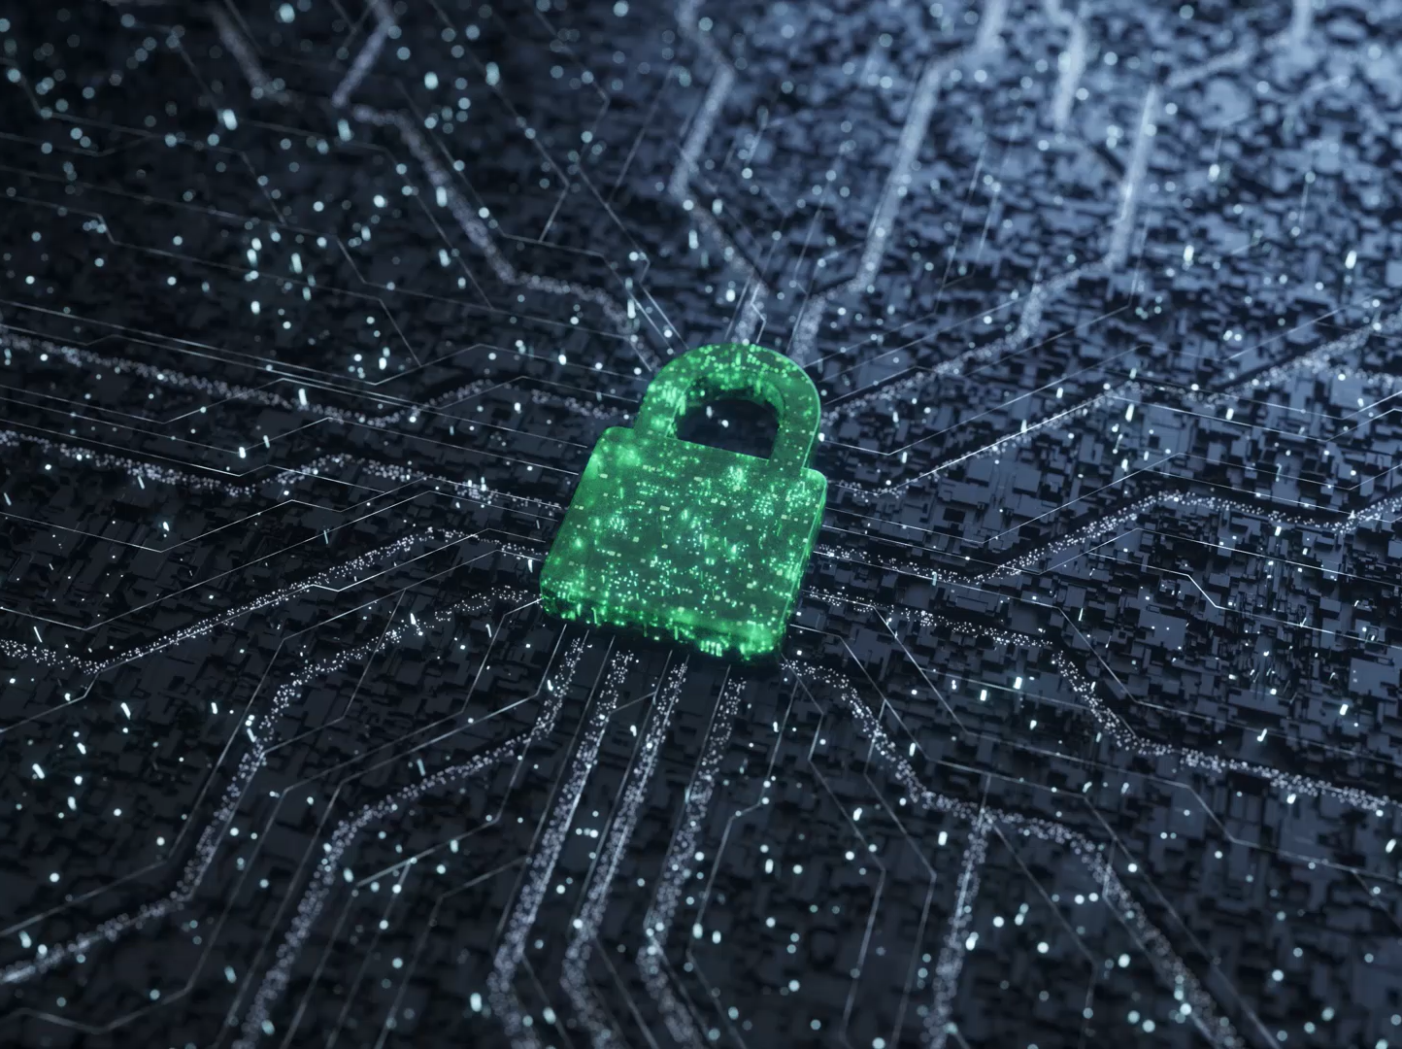
Information Security in the Age of AI
Lecture 1: AI Changes the Threat Landscape
Notes:
How has information security has changed due to the onset of AI. We’re not just describing tools, we’re analysing how AI shifts threat capability, organisational risk, and security decision-making. We’ll use New Zealand examples including tertiary education, SMEs, government, healthcare, and financial services.

Slide 2

Learning outcomes
Explain how AI has changed cyber threats (speed, scale, realism)
1
Identify AI-driven risks relevant to NZ organisations
2
Critique “old security assumptions” that no longer hold
3
Recommend controls that reduce AI-enabled incidents
4
Notes:
Your focus is not “AI is scary”. Your focus is: what changed, why it matters, and what a security professional would do about it in a real organisation here in NZ.

Slide 3
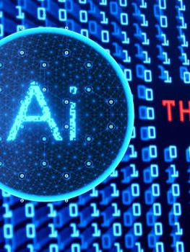
What changed when AI arrived?
Scales attacks (volume + speed)
Improves quality (convincing writing/voice/video)
Automates discovery (recon + targeting)
Lowers skill barriers (more attackers can participate)
Creates new assets to protect (models, prompts, AI tools)
Notes:
AI doesn’t only create new threats, it increases the effectiveness of existing ones. The biggest shift is personalised attacks at scale.

Slide 4

Old InfoSec assumptions that don’t hold anymore
“People can spot phishing if we train them once”
“Attackers need strong technical skills”
“Security teams can manually review everything”
“Email fraud is easy to recognise”
“If it’s inside the organisation, it’s safe”
Notes:
Many security strategies were built around humans being the main bottleneck. AI removes bottlenecks for attackers.

Slide 5

NZ context: what sectors are exposed?
Education (student records, staff access, open networks)
Healthcare (privacy + urgent operations)
Local government (public trust + legacy systems)
Financial services (fraud, identity, social engineering)
SMEs (low security maturity, high reliance on SaaS)
Notes:
NZ organisations often have lean IT teams and heavy SaaS use. AI-enabled social engineering and credential theft can be more damaging than purely technical attacks.

Slide 6
Threat landscape: before vs after AI
Before AI:
Manual phishing
Obvious scam writing
Slower targeting
Higher attacker skill required
After AI:
Personalised phishing at scale
Perfect grammar + tone matching
Deepfake voice/video scams
Rapid targeting of roles/teams
Notes:
The most important phrase here is personalised at scale. Users can’t rely on spotting bad grammar anymore.
How hackers are exploiting artificial intelligence
Artificial intelligence (AI) is transforming cybercrime. Sophisticated attacks used to take skilled hackers months to plan and prepare. Today, they can be automated and executed easily in minutes.
Traditional attacks used crude spray-and-pray tactics. By contrast, AI-powered attacks identify targets carefully, calculate optimal strike times, and adjust their approach to ensure maximum impact.
Some reports say 40% of business email compromise (BEC) messages are now generated using AI. This represents a major shift in how digital crimes are committed, and businesses must adapt their defences.
How AI helps hackers launch faster and more sophisticated attacks
Cybercriminals use key capabilities of AI:
Automation to launch thousands of attacks simultaneously.
Adaptation to modify their tactics in real time to get around defences, learning from failed attacks to increase their chances of success next time.
Unprecedented scale to target millions of potential victims.
Automated vulnerability scanning
AI systems can scan millions of code lines across GitHub repositories, software updates, and system configurations to detect unpatched vulnerabilities and zero-day exploits far faster than before.
Speed and scale
Cybercriminals train AI models to penetrate firewalls, endpoint protection, and intrusion detection systems, testing thousands of variations to find ways in.
They can also attack at scale. Human hackers might attempt dozens of attacks daily, whereas AI systems can launch millions.
Indicators of AI-driven attacks include:
Unusually rapid attack variations.
Perfectly timed strikes during off-hours.
Simultaneous multi-vector approaches.
Adaptive responses to defensive measures.
Sleeper threats
AI can learn how a system behaves to create advanced persistent threats (APTs) or sleeper threats. These can remain undetected for months, gathering intelligence and waiting for the most damaging moment to strike.
Democratisation of sophisticated attacks
With AI, low-skilled criminals can launch enterprise-grade attacks. Cybercrime has never been easier, and the potential impact has never been higher.
Types of AI cyberattacks and AI-powered hacking
Automated phishing: The personal touch at scale
Cybercriminals use AI to create highly personalised and convincing phishing messages.
For example, they can reference the victim’s recent purchases, or projects, or personal stories. They can also mimic the writing style of someone they know. As a result, click rates can be up to 40% higher than traditional phishing attacks.
AI-enhanced malware: Shape-shifting threats
Today’s malware is polymorphic. Using machine learning, it can study its target environment and modify its code to evade detection. By continuously changing its signatures, it can sidestep traditional antivirus solutions.
Some infostealer malware uses AI to identify the most valuable data to steal and the best time to steal it.
Deepfake scams: When seeing isn’t believing
Cybercriminals are using deepfake audio and video to impersonate people. For example, senior executives, IT personnel, or important clients or partners.
For example, in 2024 the CEO of WPP, the world’s largest advertising agency, warned the firm’s leadership to be on their guard after scammers impersonated him in a fake video call.
Building a cyber security strategy for the AI age
Start with these critical steps:
Deploy AI-enhanced security tools that can match the speed and adaptability of AI attacks.
Train employees to be aware of the risks and recognise AI-generated content and deepfakes.
Regular security assessments that test for AI-attack vulnerabilities.
Develop incident response plans that account for AI-speed attacks.
Implement continuous credential monitoring to detect compromised accounts before they’re exploited. Cybercheck provides real-time. Our solution’s continuous monitoring and real-time alerts help you to detect and respond to threats before they escalate.
With vigilance, the right tools, and a culture of security awareness, you can protect your business, your customers, and your reputation.

Slide 7
AI-enabled social engineering (the #1 risk)
Tone mimicry (sounds like your manager)
Realistic context (projects, names, deadlines)
Deepfake voice messages
Fake Teams/Zoom meeting links
Multi-step “conversation phishing”
Notes:
A common NZ example is invoice fraud. AI makes impersonation far more convincing.

Slide 8

Deepfakes and impersonation: why it matters in NZ
CEO/CFO voice scams in finance teams
Fake “IT Service Desk” calls to staff
Fake video requests during remote work
Fake student/staff identity for account resets
Notes:
Remote work increases reliance on digital trust signals. Deepfake audio/video means voice is no longer proof of identity.

Slide 9
AI and malware: what’s actually changing
Speeds up scripting and variations
Helps low-skill attackers write working code
Improves phishing-to-malware delivery rates
Supports faster vulnerability research
Notes:
Be careful with hype: AI doesn’t make everyone elite, but it increases volume and lowers barriers.

Slide 10
Attack lifecycle with AI embedded
Recon: automated OSINT profiling
Delivery: tailored messages and timing
Exploitation: faster matching of known vulnerabilities
Actions: automated data theft and cover stories
Notes:
AI affects multiple stages, not just phishing. That’s why layered defence is essential.

Slide 11
NZ case scenario: tertiary sector phishing
Scenario: urgent email to review a student complaint file
Red flags: urgency + emotional pressure + attachment/login link
Discussion: what controls should exist even if it looks real?
Notes:
Students should propose layered controls: MFA, safe links, attachment scanning, least privilege, and reporting culture.

Slide 12
Controls that matter more in the AI era
Phishing-resistant MFA where possible
Privileged access management
Email security and domain protections
Logging + monitoring
Payment verification processes
Data classification + DLP
Notes:
In the AI era, assume humans will sometimes be fooled. Controls must reduce impact and enable fast response.

Slide 13
NZ scenario: invoice fraud in an SME
Scenario: supplier requests bank account change via email
Risks: business email compromise + weak verification
Best practice: out-of-band verification + two-person approval
Notes:
This is a governance and workflow control issue. Email should never be treated as proof of payment instruction changes.

Slide 14

Quick check (assessment style)
Explain two ways AI changes cyber risk for NZ organisations
Recommend two controls that reduce impact
Notes:
Encourage one social/people-based change and one technical change, with controls that include both technology and governance.

Slide 15
Lecture 1 summary
AI scales and improves social engineering
Trust signals (voice/video/writing) are less reliable
AI lowers barriers and increases attack volume
NZ organisations need layered controls + strong processes
Notes:
AI doesn’t replace security fundamentals — it stresses them. Identity, governance, monitoring, and resilient processes matter more than ever.

